Slide 1
Galasa Development Progress TSC Aug 2024

Slide 2
Agenda
Recent improvements
Roadmap

Slide 3
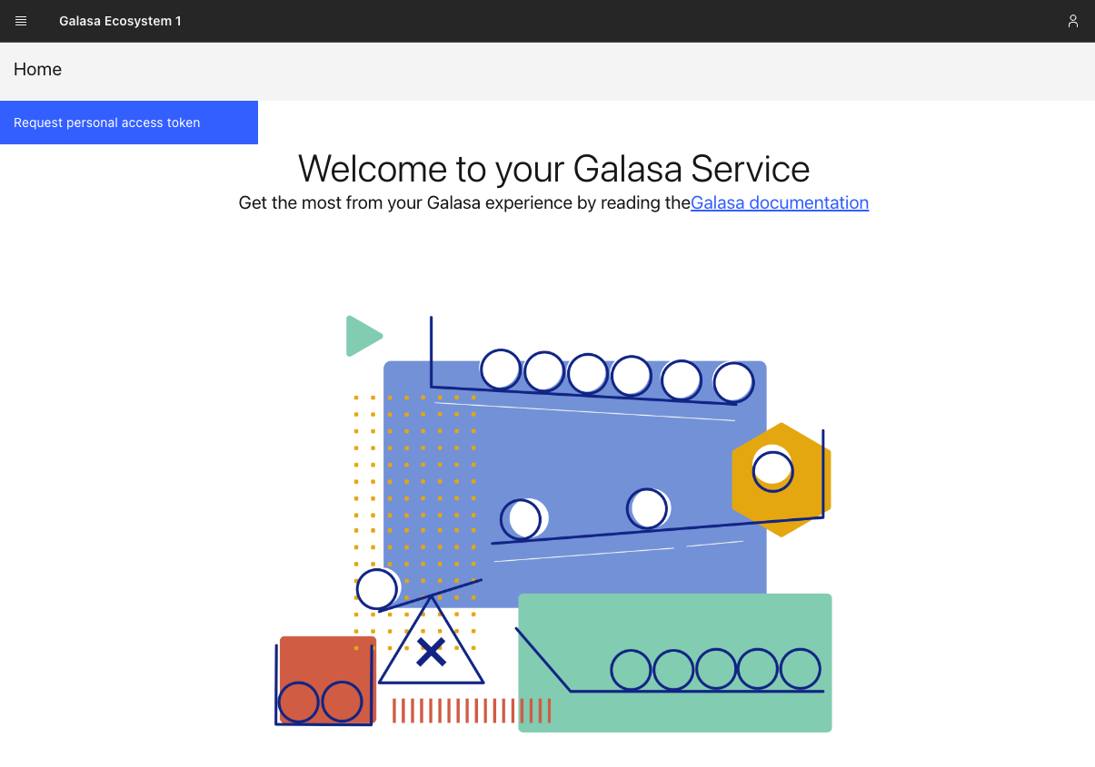
Web UI changes

Slide 4
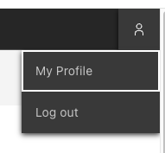
Web UI changes

Slide 5
Listing and revoking access tokens with galasactl
galasactl auth tokens get
Lists all token records in the Galasa ecosystem (not the actual tokens themselves!)
galasactl auth tokens delete --tokenid <access_token_id>
Revokes an access token with the given ID, stopping it from being used to get new JWTs in the future
Access to the Galasa ecosystem becomes limited to the validity of existing JWTs
Ecosystem admins can configure JWT expiry to keep them short-lived

Slide 6
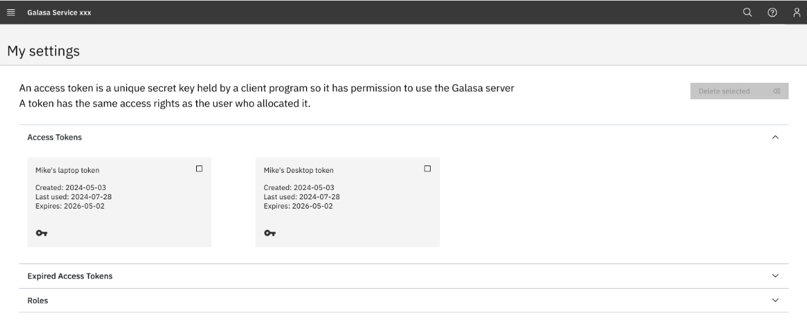
Planned – Manage personal access tokens

Slide 7
Gradle 8
In 0.36.0, Gradle 8.9 can be used to build Galasa test projects
Documentation on migrating existing projects is in the Galasa documentation
Gradle 6 and 7 are still supported - migration can be performed when desired
Galasa's build process now uses Gradle 8.9

Slide 8


Kafka support
events
Real-time test status reporting of test status changes. Eg: Started/Passed/Failed
Optional
Future: assess performance qualities, improve based on feedback, add event consumption, and a Kafka Manager.

Slide 9
Gherkin – Support scenario outline + Examples
Feature: Test 3270 interactions
Scenario Outline: Run a named transaction and check the result
Given a terminal
# Login to zOS
Then wait for "MYCLUSTER1 VAMP" in any terminal field
And type "LOGON APPLID(MYAPPLID1)" on terminal
And wait for terminal keyboard
And press terminal key ENTER
Then wait for "*****" in any terminal field
And press terminal key CLEAR
And wait for terminal keyboard
# Run a transaction
And type "<transaction>" on terminal
And press terminal key ENTER
Then wait for "<expectedMessage>" in any terminal field
Examples:
| transaction | expectedMessage |
| GRK1 | TEST MESSAGE |
| GRK2 | SECOND TEST |
| GRK3 | THRICE THIS |

Slide 10
Gherkin - terminal sizes
Set the two CPS properties to control the default size of the terminal​
- `zos3270.gherkin.terminal.rows` defaults to 24 if missing.​
- `zos3270.gherkin.terminal.columns`defaults to 80 if missing.​
- `GIVEN a terminal`
- `GIVEN a terminal with id of xxx`
- `GIVEN a terminal tagged yyy`
- `GIVEN a terminal with id of xxx tagged yyy`
- New: `GIVEN a terminal with 48 rows and 160 columns`
- New: `Given a terminal B with 24 rows and 160 columns`
- New: `Given a terminal C tagged ABCD with 24 rows and 80 columns`

Slide 11
Local Test Run configurations
Local Machine
JVM
Local File System
Configuration Properties
Testcase run
Credentials& Results
Remote Galasa Server
JVM
Local File System
Remote Galasa Server
Local cache
https/REST
Configuration Properties
Testcase run
(JWT authenticated)
Credentials & Results
framework.cps.rest.cache.is.enabled true/false

Slide 12
Mac install of command-line tool
Mac users can install the galasactl command-line tool using the popular `homebrew`installer
brew tap galasa-dev/tap
brew install --no-quarantine galasactl
brew install --no-quarantine galasactl@0.36.0

Slide 13
Galasa Roadmap
Key: Completed and released Started Not Started
3Q 2024 | 4Q 2024 | 1Q 2025 | 1Q 2025 and beyond
Security items List and Revoke access tokens (Web UI) Others Java v17 Gradle 8.0 (currently 6.9) Github actions build process Gherkin scenario outlines Gherkin configurable 3720 screen size Local tests can use remote configuration Brew install command-line tool on mac Customer Adoption of Galasa Generate interest through blogs, videos and conference sessions. | Galasa 1.0 HTTPS instead of HTTP inside the cluster Scan Vulnerabilities all fixed Secure Local secrets Ecosystem draws test from password protected repo Secrets in ecosystem encrypted Easy way of adding public certificates so tests can contact things over https Others Mono-repo with Github Actions build process Upgrade etcd Infrastructure Migrate to 'OMP' cloud account Ecosystem Admin Functions CLI delete test run information Customer Adoption of Galasa Generate interest through blogs, videos and conference sessions. | Others Remove testcatalog endpoint Kafka-published test lifecycle change events Secrets sync'ed from IBM Cloud Secrets Manager Acquire requirements from clients (eg:CICS team) about reporting Basic test status reporting from Kafka events Easier to use/maintain Schedule tests in queues Role-based access (admin vs. Non-admin) CLI Configure Ecosystem streams (CRUD) CLI Monitor and Cleanup of DSS CLI Configure credentials (CRUD) Customer Adoption of Galasa Generate interest through blogs, videos and conference sessions. | Configure Ecosystem Web UI Web UI configure CPS properties (CRUD) Test Scheduling Others Reporting Web UI Web UI Monitor and Cleanup of DSS Web UI Monitor and Cleanup of CPS space Web UI configure streams (CRUD) Integrate with other OMP projects Customer Adoption of Galasa Generate interest through blogs, videos and conference sessions.

Slide 14
Thank you!

Slide 15
Continuous Delivery
Galasa Version | Release Date | Highlights
0.36.0 | Aug 13th 2024 | Revoke tokens from CLI, Gherkin terminal size + scenario outlines Local test can use cached remote CPS configuration. Gradle 8.
0.35.0 | June 27th 2024 | Local test can use remote CPS configuration. DB2 manager fixes.
0.34.0/0.34.1 | June 10th/12th 2024 | Remote CPS for local test runs
0.33.0 | May 2024 | Authentication mandatory. CouchDB upgrade. Updated gradle&maven plugins.
0.32.0 | March 2024 | Reset/Cancel runs which hang. Run local Gherkin tests. Eclipse plugins withdrawn
0.31.0 | Jan 2024 | Authentication (optional) CLI set/create/update properties in yaml format
0.30.0 | 2023-Oct 19 | CLI can set/get property values in Ecosystem CLI requestor is always the user id of caller
0.29.0 | 2023-July 5 | Security fixes
0.28.0 | 2023-June 15 | CLI get list of historical runs CLI get details of a historical run CLI download artifacts from a historical run CLI debug testcases in Eclipse/VSCode/IntelliJ
0.27.0 | 2023-May | CLI Get status of a historical run CLI uses $GALASA_HOME environment variable
0.26.0 | 2023-March 26 | CLI launches local test run
0.25.0 | 2023-Jan 23 | Stable builds
Note: Pre-release builds of Galasa code and Documentation are visible externally on main branch every build

